Slide 1


Slide 2
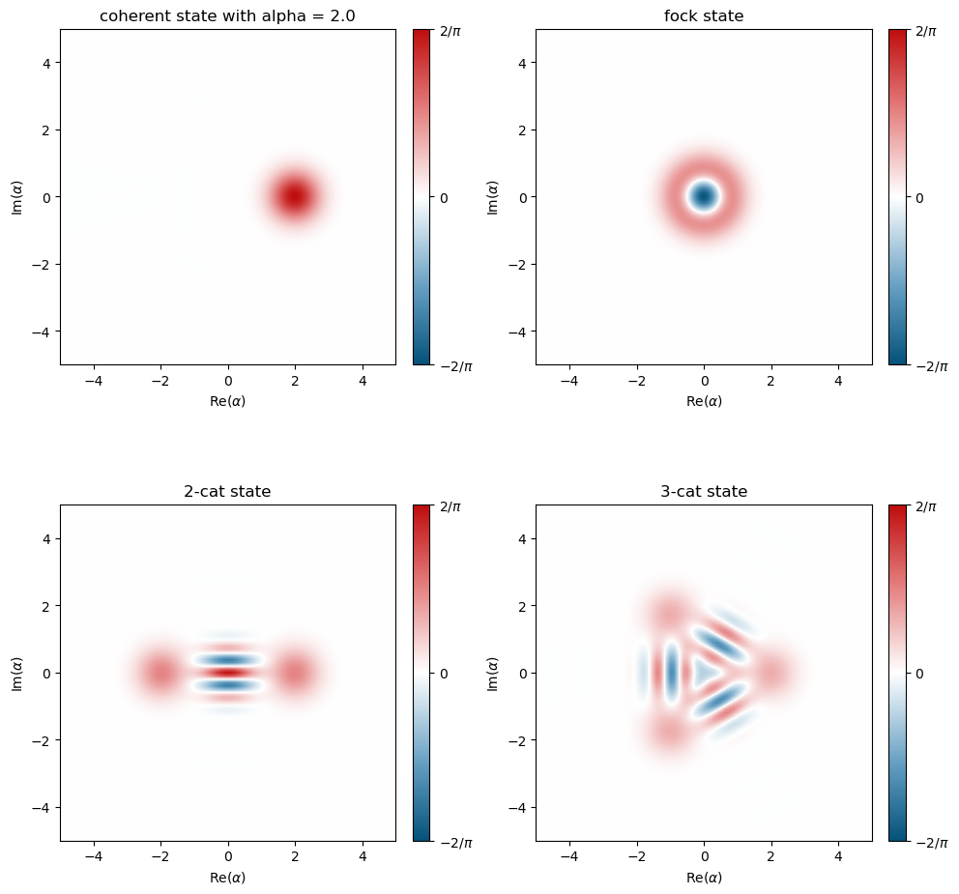
1.A. Generating Wigner Functions
1.A.1. Static Wigner function plots

Slide 3
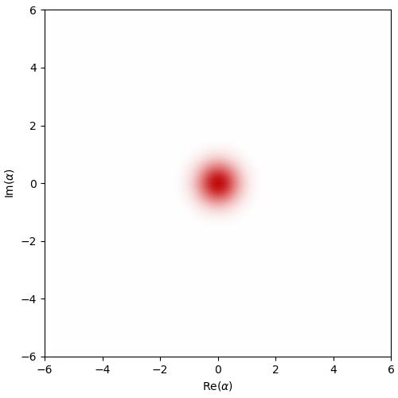
1.A. Generating Wigner Functions
1.A.2 Dissipative cat state’s Wigner function

Slide 4
1.B. Density Matrix Reconstruction from Wigner Data
1.A.1. Static Wigner function plots

Slide 5
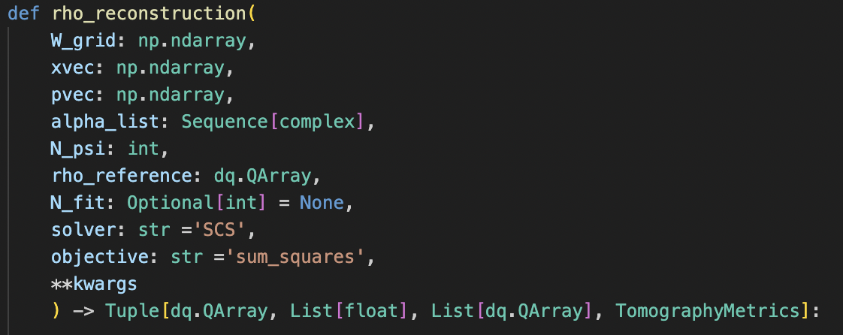
1.B. Density Matrix Reconstruction from Wigner Data
1.B.1. rho_reconstruction method
Validate shape of xvec, pvec and W_grid.
Make a wigner interpolation in the range of xvec and pvec.
Calculate $w_{k}$ from alpha_list.
Calculate $E_{α}$ from alpha_list.
Define $ρ_{obj}$ with constrains (cvxpy).
Calculate $p=Tr(E_{α}ρ_{obj})$
Minimize using ‘objective’ $dist(p-w_{k})$.
Get metrics (fidelity, trace distance, etc.)

Slide 6
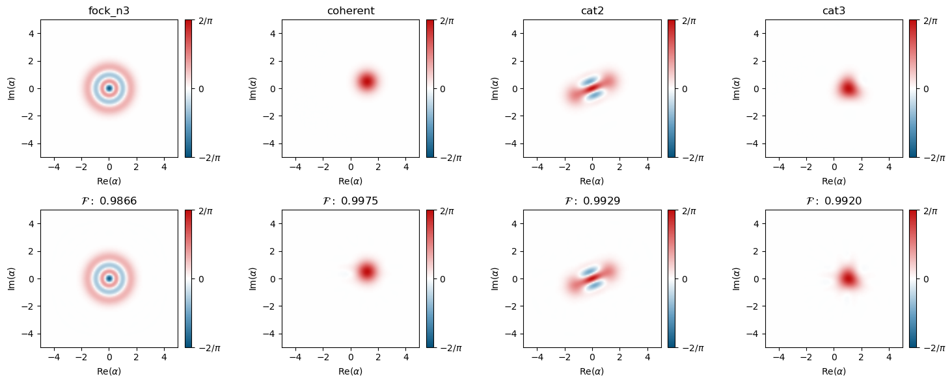
1.B. Density Matrix Reconstruction from Wigner Data
1.B.2-3. Synthetic data
N = 30
N fit = 100
$α$ points: 200 x 200
0.013727
0.022967
0.012412
0.033844
Trace distances

Slide 7
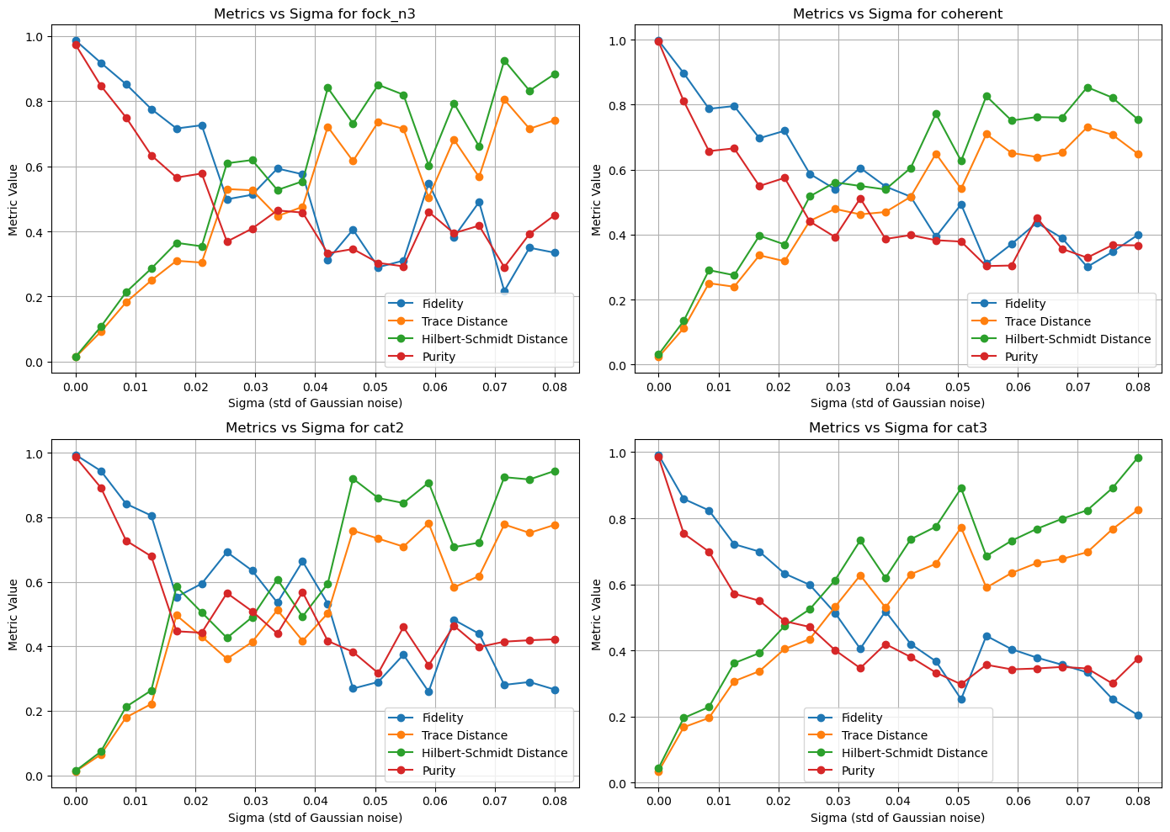
1.C. Robustness of the fit
1.C.1. Gaussian noise

Slide 8
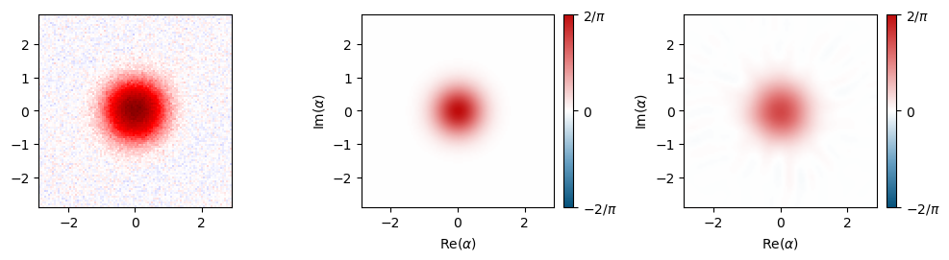
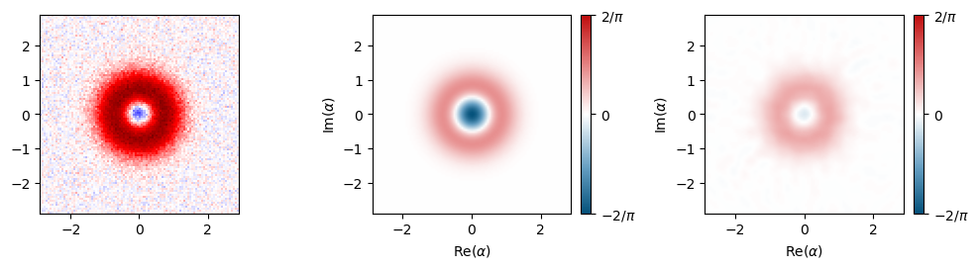
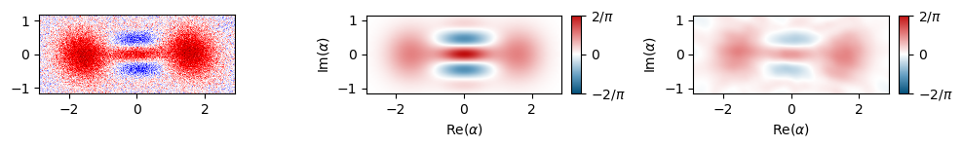
1.C. Robustness of the fit
Experimental data
Wigner reference
Wigner reconstruction
$$|0⟩$$
$$|1⟩$$
$$|\sqrt{2.5}⟩$$

Slide 9
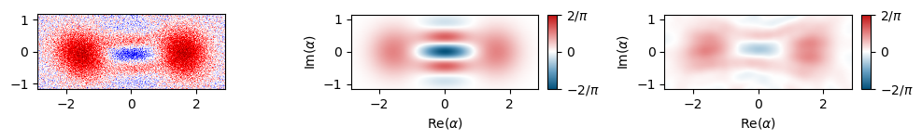
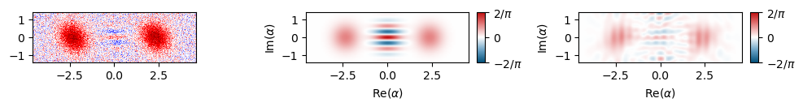
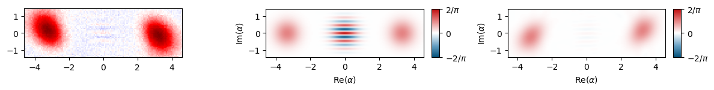
1.C. Robustness of the fit
Experimental data
Wigner reference
Wigner reconstruction
$$|-\sqrt{2.5}⟩$$
$$|\sqrt{5.6}⟩$$
$$|\sqrt{11.3}⟩$$

Slide 10
1.C. Robustness of the fit
Fidelity
Trace distance
Purity
$$|0⟩$$
0.868
0.868
0.770
$$|1⟩$$
0.519
0.482
0.438
$$|\sqrt{2.5}⟩$$
0.679
0.352
0.568
$$|-\sqrt{2.5}⟩$$
0.609
0.422
0.532
$$|\sqrt{5.6}⟩$$
0.525
0.556
0.533
$$|\sqrt{11.3}⟩$$
0.487
0.540
0.500

Slide 11
Bonus

Slide 12
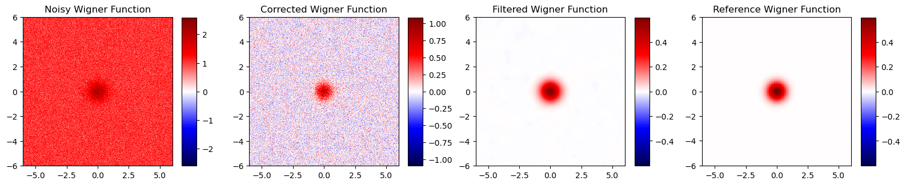
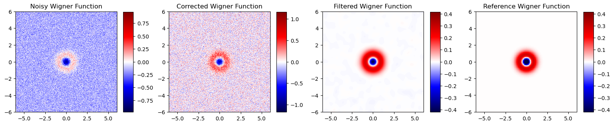
2. Denoising
2.A. Correcting Affine Distortions and Background Noise

Slide 13
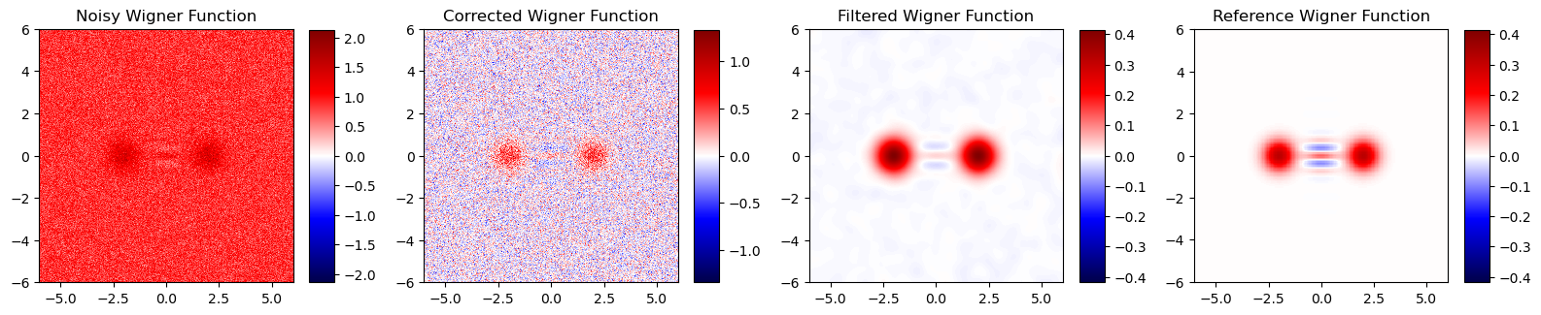
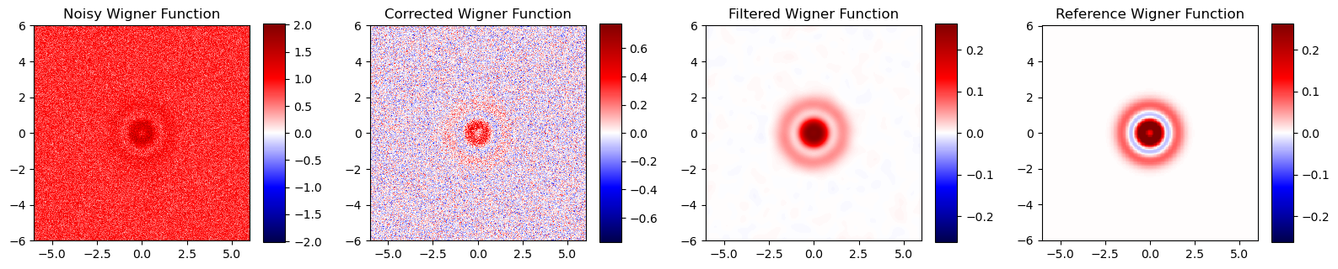
2. Denoising
2.A. Correcting Affine Distortions and Background Noise

Slide 14
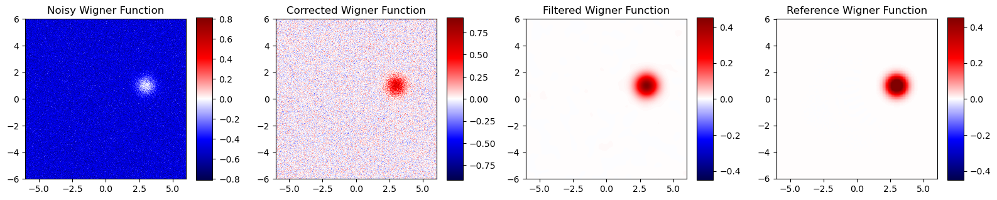
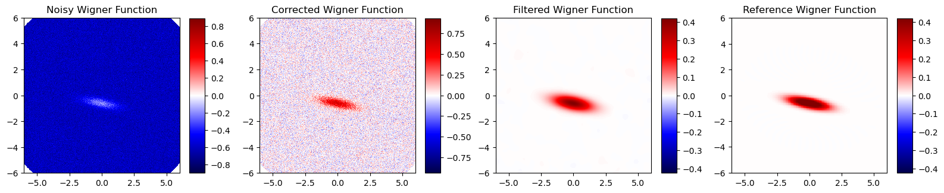
2. Denoising
2.A. Correcting Affine Distortions and Background Noise

Slide 15
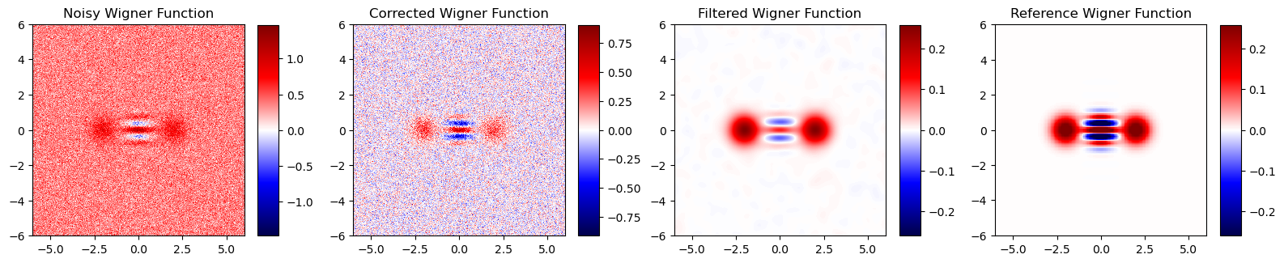
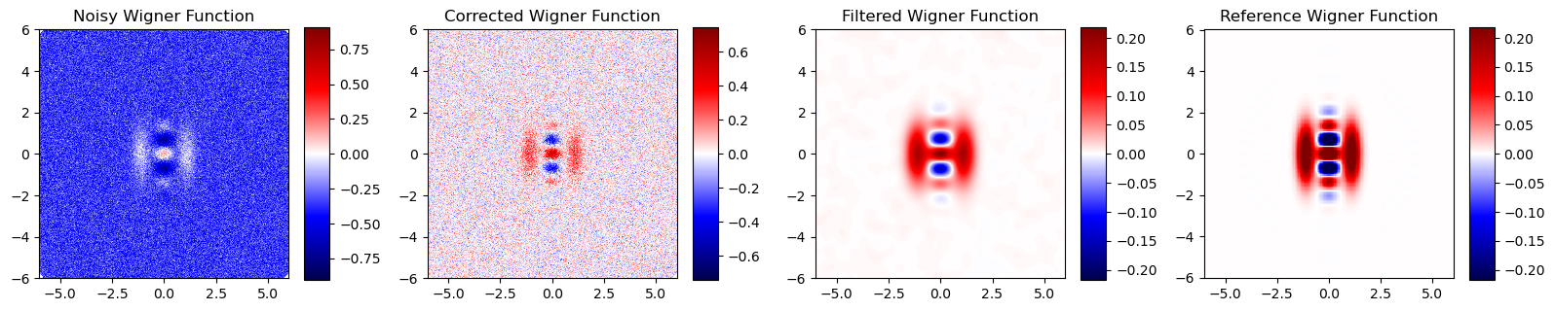
2. Denoising
2.A. Correcting Affine Distortions and Background Noise

Slide 16
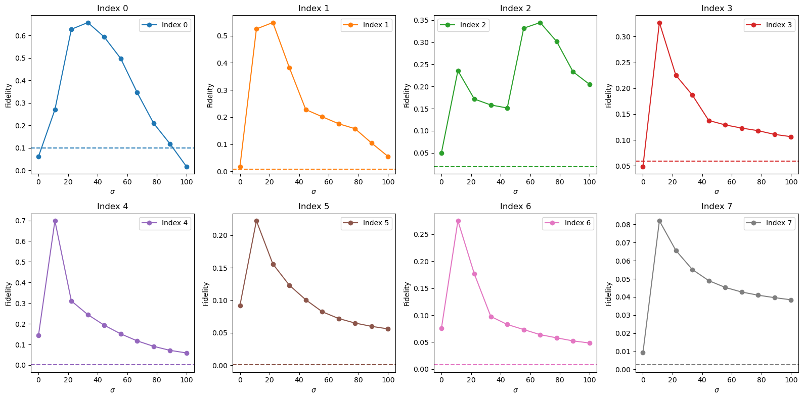
2. Denoising
2.A. Correcting Affine Distortions and Background Noise
A filter with $σ≈20$ tends to work better for all the measurements

